Slide 1
Research Computing Orientation Introduction for Research Fellows
June 20, 2019
Notes:
Welcome. We are so happy you’re here.

Slide 2
Overview
Goals
Learn the Kellogg research computing environment
Hands on experience of fundamentals
Reproducibility and your future self

Slide 3
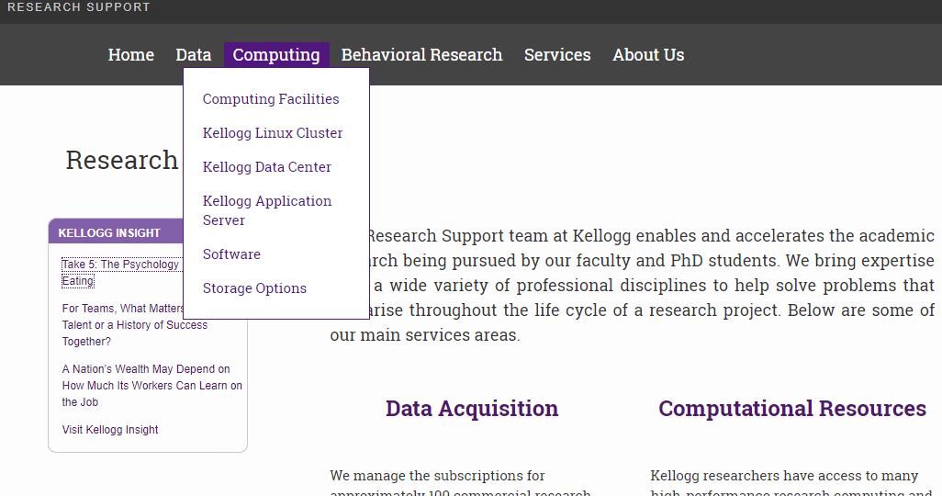
Research Support on the Web
www.kellogg.northwestern.edu/rs

Slide 4


Computing Ecosystem
Kellogg Linux Cluster
Large RAM and storage.
Great for most problems.
Northwestern Quest
Must apply, uses job scheduler.
Great for high CPU problems.
Kellogg Data Center
High-performance SQL Server.
Great for big datasets (> 2 TB).
KAP02 Windows Server
Has encrypted storage volume.
Great for special-use cases.
http://www.kellogg.northwestern.edu/rs/computing
Notes:
Lastly, you might hear some colleagues tell you about KAP02 or share data with you there.
That is now our oldest system and less powerful than KLC.
Probably not a wise place to be your primary work platform.
Good for special uses, such as when you need Windows software or when you need to use the secure storage volume.

Slide 5

Computing Ecosystem
Kellogg Linux Cluster
Large RAM and storage.
Great for most problems.
Northwestern Quest
Must apply, uses job scheduler.
Great for high CPU problems.
Kellogg Data Center
High-performance SQL Server.
Great for big datasets (> 2 TB).
KAP02 Windows Server
Has encrypted storage volume.
Great for special-use cases.
http://www.kellogg.northwestern.edu/rs/computing
Notes:
Lastly, you might hear some colleagues tell you about KAP02 or share data with you there.
That is now our oldest system and less powerful than KLC.
Probably not a wise place to be your primary work platform.
Good for special uses, such as when you need Windows software or when you need to use the secure storage volume.

Slide 6
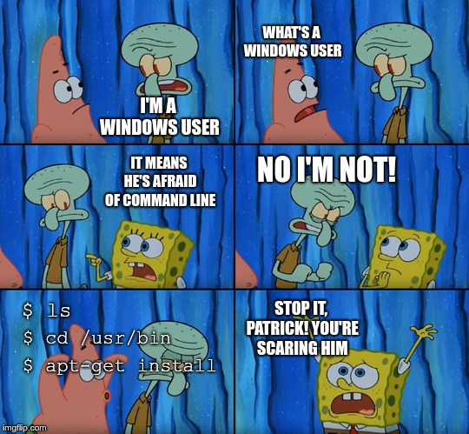
Part I – Kellogg Linux Cluster

Slide 7
Part I – Kellogg Linux Cluster
DON'T FEAR THE COMMAND LINE!
Goals
Connect to KLC (FastX)
Clone our Github repo
Navigate directories
Edit a file
Launch a batch process and keep it running
Use a GUI
Transfer files

Slide 8
Part II – WRDS
Goals
Why use WRDS?
Use their web interface
Connect to WRDS Cloud (ssh client)
Run a batch job to work with SAS data

Slide 9
Popular Data Sources
Data Source | Type of Data | # Queries
CRSP | Stock and bond prices | 8,921
TAQ | Intra-day trade and quote information | 2,829
Compustat | Company financial statements | 1893
Ravenpack News | Corporate news content and classification | 609
IBES | Security analyst estimates | 602
Option Metrics | Option prices and volatility | 486
Fama-French | Portfolios and liquidity factors | 411
TFN | Mutual fund, inst., and insider holdings | 276
Bureau van Dijk | European (Amadeus) & unlisted (Osiris) stocks | 164
Honorable Mentions:
ETF Global, Eventus

Slide 10
During the Break.....
Please install a FreeTDS Driver.
To do so, open a Terminal Window on KLC and type:
Thanks!
. /kellogg/bin/freetds_config

Slide 11
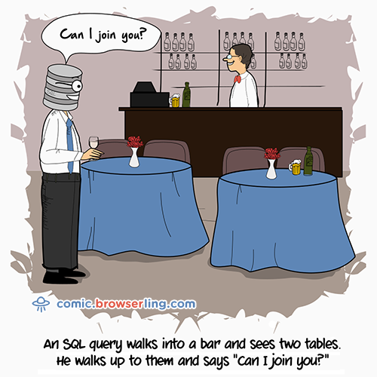
Part III – KDC

Slide 12
Part III – KDC
Goals
Find information about databases on KDC
Query KDC databases from KLC (R, python)
Integrate query results with downstream KLC work
If you need a SQL Primer:
SQL Review File on our github: taxi.sql
Khan Academy: https://www.khanacademy.org/computing/computer-programming/sql

Slide 13
Part IV – Reproducibility Matters

Slide 14
Reproducibility Matters to...
… journals
… referees
… readers
… your co-authors
… your RAs
… your ORI
… all scientists
Notes:
(John)

Slide 15

Reproducibility Matters to...
… journals
… referees
… readers
… your co-authors
… your RAs
… your ORI
… all scientists
… and your future self!
Notes:
(John)

Slide 16
Reproducible Research Challenges
Collaboration is messy.
Did your colleague…
...change the model specification from what your paper says?
...put the correct Table 4a. in your draft?
...accidentally overwrite a file?
...intentionally overwrite a file?
...quit the project?
...
(These kinds of problems happen outside research too.)
Notes:
(John) Return to this theme of collaboration. Coordinating the actions of people is an inherently complicated problem. This is true in many lines of work, and it’s also true outside of work. If collaboration were easy, schools like Kellogg would not exist, and most of you would not have dissertation topics. Thankfully, many of the same principles about managing teams can help you think about managing code or data.

Slide 17
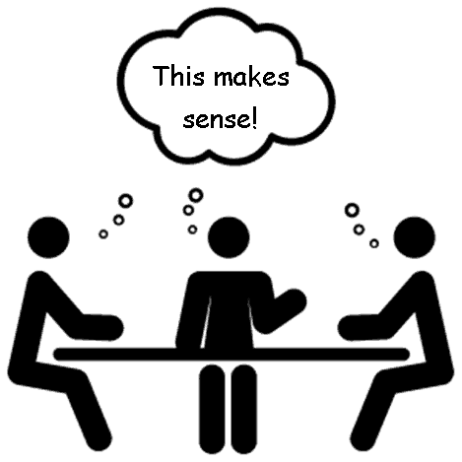
Collaborate Well
Clear vision and expectations.
Transparency: What’s done, not done.
Reduce cognitive load, communication cost.
Automate what you can.
Keep good records.
Notes:
(John) Thankfully, this building is full of people with ideas for why some collaborations work, others fail. We can use that knowledge to apply to our problem of research collaboration.

Slide 18
Get Organized
This is a real RS directory with code & data that monitors load on KLC.
Where do you find which jobs were running during yesterday’s peak demand?
active_netids.txt
active_usernames.txt
daily_email.sh
email_lookup.py
emails_of_active_users.sh
loadavg.gnuplot
loadavg_history.klc01.txt
loadavg_history.klc02.txt
loadavg_history.klc03.txt
loadavg_history.klc04.txt
loadavg_history.klc05.txt
loadavg.png
monitor_load.sh
netids_of_active_users.sh
renice/
users_history.klc01.txt
users_history.klc02.txt
users_history.klc03.txt
users_history.klc04.txt
users_history.klc05.txt
vmstat.gnuplot
vmstat_history.klc01.txt
vmstat_history.klc02.txt
vmstat_history.klc03.txt
vmstat_history.klc04.txt
vmstat_history.klc05.txt
vmstat.png
Notes:
(John)

Slide 19
Directory Structures
Suggestion: Use intuitive directory and file naming conventions.
renice/
README.txt
inputs/
outputs/
programs/
run_logs/
versions_old/
programs/
1_get_ps.py
2a_sum_users.py
2b_sum_load.py
3_make_graphs.py
4_send_email.py
RUN_ALL_PROGRAMS.sh
Notes:
(John) Conventions reduce cognitive load.

Slide 20
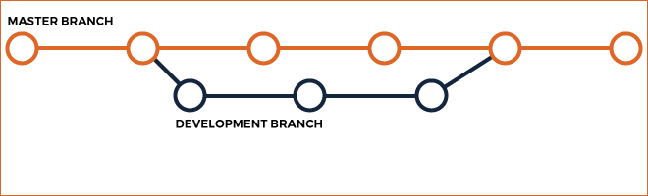
Version Control in Software Development
New features can get developed (and tested) in parallel.
Easy way to recover previous versions.
Caution: The tool requires human judgment, collaboration to be used well!

Slide 21
What Else to Curate
Package version control
Python: virtualenv
R: Packrat
Containers (software dependencies)
Singularity (on Quest)
Docker

Slide 22
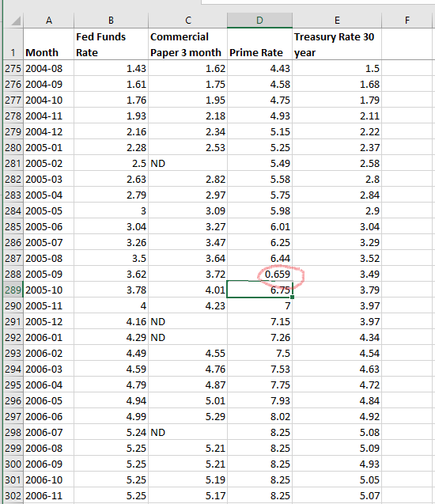
Automation - Motivation
Suppose your original source document for interest rate information looks like this.
Cell D288 has an error.
You could fix it by hand right now.
Should you?
Notes:
(John)

Slide 23
Automation
Manifesto: Automate everything that can be automated!
Why?
Efficient for you
Replication is simple
Automatic audit trails
Avoid:
Manual changes to documents
Interactive, point and click work
Notes:
SHOW ME HOW

Slide 24
Automation with Executable File
Make a file called my_exec : ...then on the command line:
# Run a Python program
module load python/anaconda3.6
python time.py
# Run R Program w/ Timestamp
date
echo “R program began”
module load R
Rscript hello.R
date
echo “R program finished”
# Download a file from the internet
wget "https://www2.census.gov/.../all_al.zip"
# Zip a file
gzip 8K_urls.txt
~]$ chmod +x my_exec
~]$ ./my_exec > /path/to/log
Notes:
SHOW ME HOW

Slide 25
Abstraction
Programming principle that lets you:
Minimize redundancy
Write modular functions
Isolate parameters that might change
Reducing code complexity
Notes:
richard

Slide 26
Documentation
Document everything!
Notes:
richard

Slide 27
Documentation – Less is More
Document everything!
Only document what you are willing to maintain.
Comment your code judiciously.
consistency between code, comments
kind to the person reading them
Use functions to “self document” your work
Notes:
richard

Slide 28
Producing Results
Reproducing results implies you can produce them.
Debugging Advice
Break problem into discrete pieces
Test, test, test… before moving on
anticipate errors, handle them
print statements
save intermediate outputs
Notes:
Ambreen

